Slide 1
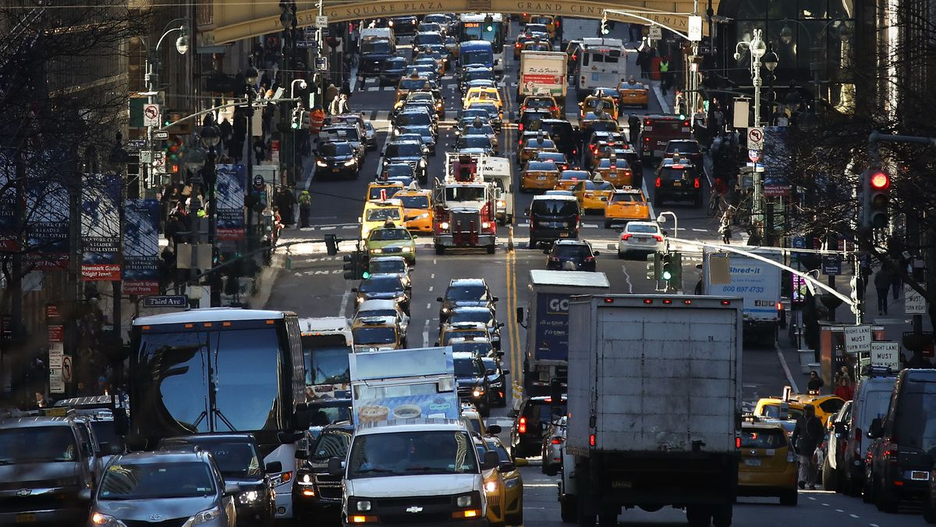
Predicting Vehicle CO₂ Emissions
A Comparative Study of Machine Learning and Deep Learning Models

Slide 2
Agenda
Introduction
Project structure & approach
Dataset overview
Electric Data Modeling
Preprocessing & dataset characteristics
Model selection & evaluation
Live showcase
Combustion Data Modeling
Preprocessing & dataset characteristics
Model selection & evaluation
Live Showcase
Conclusion & Discussion
Overall project results & challenges
Business relevance & further improvements

Slide 3
Project Plan
Analyze Datasets
Setup collaboration environment
Merge 2021-2023 EEA Data
Split up project into electrical and combustion type vehicles
Tailored data preprocessing
Model selection and hyperparameter tuning
Final model evaluation and deployment
Notes:
Showcase overall project steps
Analyze Datasets
EAA 2021-23 & French Data 2014
Setup collaboration environment
OPS (precommit hooks, code formatting & linting, app emulation, …)
Merge 2021-2023 EEA Data
shared & centralized dataset
Split up project into electrical and combustion type vehicles
next slide
Tailored data preprocessing
required due to split up of project

Slide 4
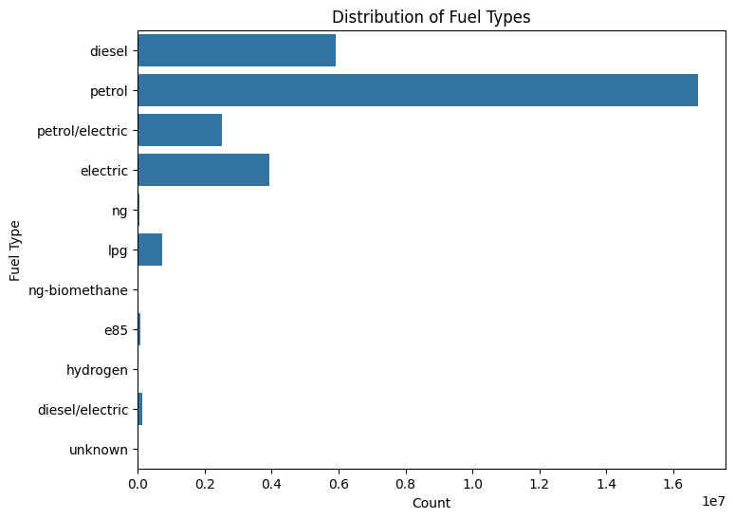
Data Overview
EEA Data (2021–2023): More than 30 million records, including vehicle mass, engine characteristics, fuel consumption and electric energy consumption
French Data (2014): Roughly 55,000 records but excluded due to ~30% missingness in critical variables such as vehicle mass
Notes:
Talk about Graph -> Explain no CO2 emissions for electric → electric energy consumption

Slide 5
Electric Data Modeling - Preprocessing
Feature Selection & Preprocessing
70% Density Threshold
Categorical Vars
Quantitative Vars
Unification
One Hot Encoding
Median
Standard Scaling
Notes:
Selected features to support prediction of electric energy consumption: member state, manufacturer name eu, vehicle type, commercial name, category of vehicle, mass vehicle, engine_power, year, electric range
3.801.601 records of type electric
Categorical vars
feature selection (remove vars below density threshold of 70%
replace missing values of quantitative vars with median
reduce/unify values of categorical vars
One Hot Encoding for categorical vars
Standard Scaling of quantitative vars
Backup missing percentages:
member_state 0.000000
manufacturer_name_eu 0.000000
vehicle_type 0.000221
commercial_name 0.005351
category_of_vehicle 0.005234
fuel_type 0.000000
fuel_mode 0.000000
innovative_technologies 0.999567
mass_vehicle 0.000016
weltp_test_mass 0.043012
engine_capacity 1.000000
engine_power 0.069891
erwltp 1.000000
year 0.000000
electric_range 0.115409
electric_energy_consumption 0.036422
fuel_consumption 0.999976
specific_co2_emissions 0.000003

Slide 6
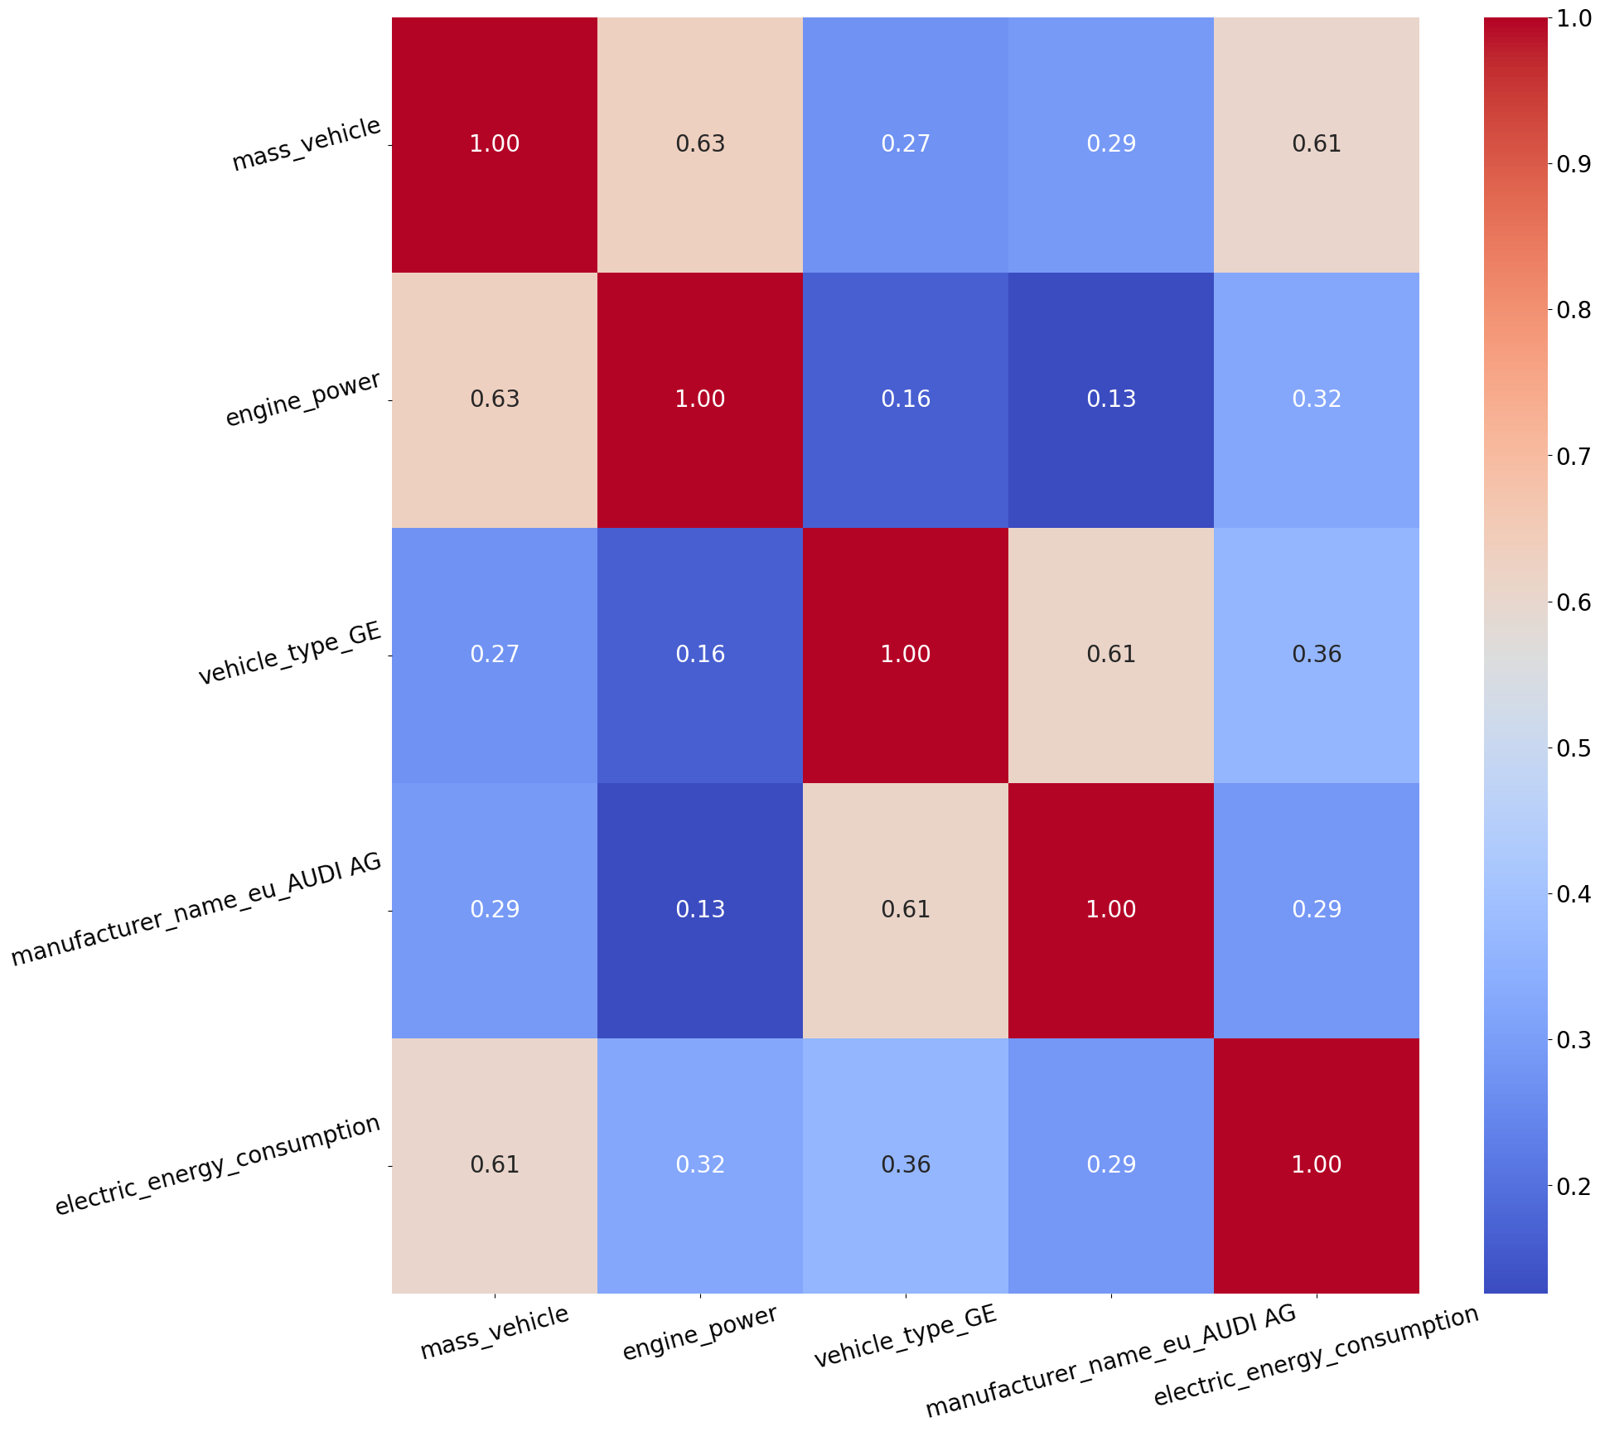
Electric Data Modeling - Preprocessing
298 features (after preprocessing)
2.661.120 records for training
1.140.481 records for testing
Random downsampling
10% of total dataset size to address computation limitations for pre-modelling stage with Lazy Regressor
Notes:
Sample heatmap of 5 features with highest correlation value
Explain importance of certain features (mass_vehicle strongest correlation to electric energy consumption, followed by engine power and encoded categorical features (vehicle type, manufacturer name)

Slide 7
Electric Data Modeling - Pre Modelling
Model | Adjusted R² | R² | RMSE | Time Taken
ExtraTreesRegressor | 0.98 | 0.98 | 3.41 | 539.32
ExtraTreeRegressor | 0.97 | 0.97 | 3.94 | 13.62
KNeighborsRegressor | 0.97 | 0.97 | 4.1 | 1019.17
LGBMRegressor | 0.96 | 0.96 | 4.95 | 11.3
HistGradientBoostingRegressor | 0.95 | 0.95 | 5.5 | 23.23
GradientBoostingRegressor | 0.89 | 0.89 | 8.19 | 149.53
DecisionTreeRegressor | 0.74 | 0.74 | 12.60 | 12.39
RandomForestRegressor | 0.74 | 0.74 | 12.53 | 292.67
Notes:
Lazy Regressor to benchmark 37 different regression models
Explain families of models
Explain metrics
Explain Model Selection for next stage (hyperparameter tuning etc)
NEXT:
Leonal will take over to explain results of the final modeling stage
Optional:
compute problems on bigger datasets, a lot of crashes, etc. (optimal would’ve been to do this on proper server infrastructure with better hardware)
performance optimization with chunks and model storage using joblib

Slide 8
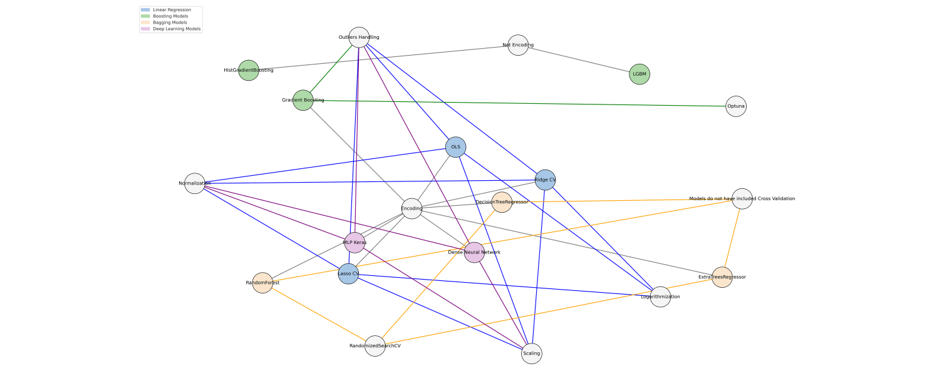
Transformations required by Learning Strategy

Slide 9
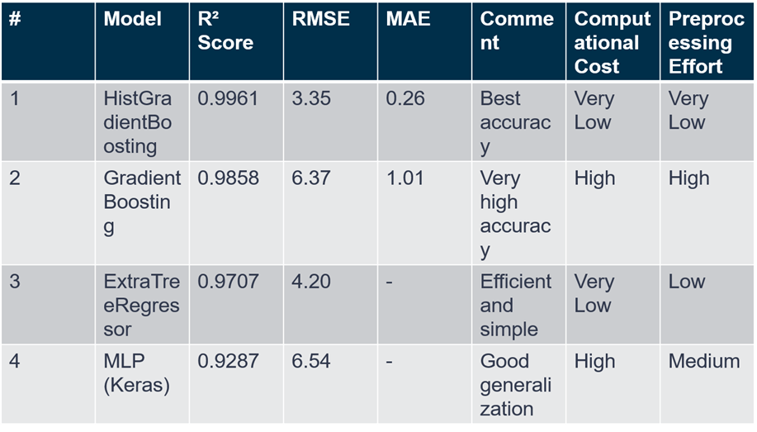
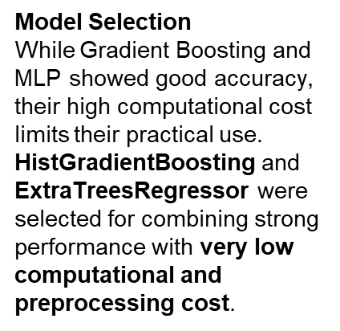
Model Selection
In the following, a prediction of the model will be presented, which was trained using a 70/30% split between training and test data.

Slide 10
Model Interpretability
The two selected models — HistGradientBoosting and ExtraTreesRegressor — not only achieved excellent predictive performance with low computational cost, but also offered strong interpretability through their feature importance rankings.
Both models consistently highlighted a similar set of key features:
• Fuel consumption and electric range: capturing the most direct relationship with CO₂ emissions.
• Engine capacity, engine power, and vehicle mass: technical characteristics that align with physical and mechanical expectations.
• Fuel type (especially petrol/electric hybrids): revealing how propulsion systems influence emission outcomes.
These insights not only validate the models’ behavior from a domain knowledge perspective, but also enhance their applicability in regulatory, industrial, or policy contexts.

Slide 11
Electric Prediction Showcase
streamlit application
Notes:
https://www.adac.de/rund-ums-fahrzeug/autokatalog/marken-modelle/lexus/ux/za1/328937/

Slide 12
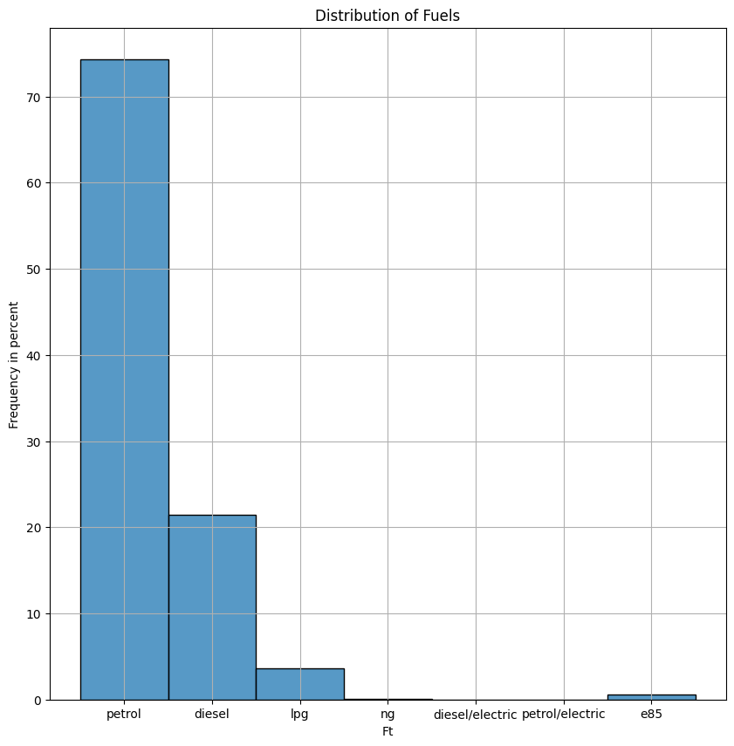
combustion engine - preprocessing
A dataset with more than 26Mio entries remained for the combustion engine part.
engine types contained:
petrol, diesel,
lpg,
diesel-electric,
petrol-electric
e85
the vast majority is diesel and petrol

Slide 13
combustion engine - preprocessing
features missing values
member_state 0.000000
manufacturer_name_eu 0.000000
vehicle_type 0.045666
commercial_name 0.276949
category_of_vehicle 0.069197
fuel_type 0.000000
fuel_mode 0.000053
innovative_technologies 28.266253
mass_vehicle 0.001050
weltp_test_mass 0.736423
engine_capacity 0.004632
engine_power 0.165367
erwltp 29.098219
year 0.000000
electric_range 90.232995
electric_energy_consumption 90.250638
fuel_consumption 8.841378
specific_co2_emissions 0.133621
dataset with 26 Mio entries after split
choice of target variable:
specific-co2-emission-wltp
fuel-consumption
one of both had to be chosen, because of too close correlation of these two variables.
the other one was eliminated out of the dataset
remaining features and missing values see right side

Slide 14
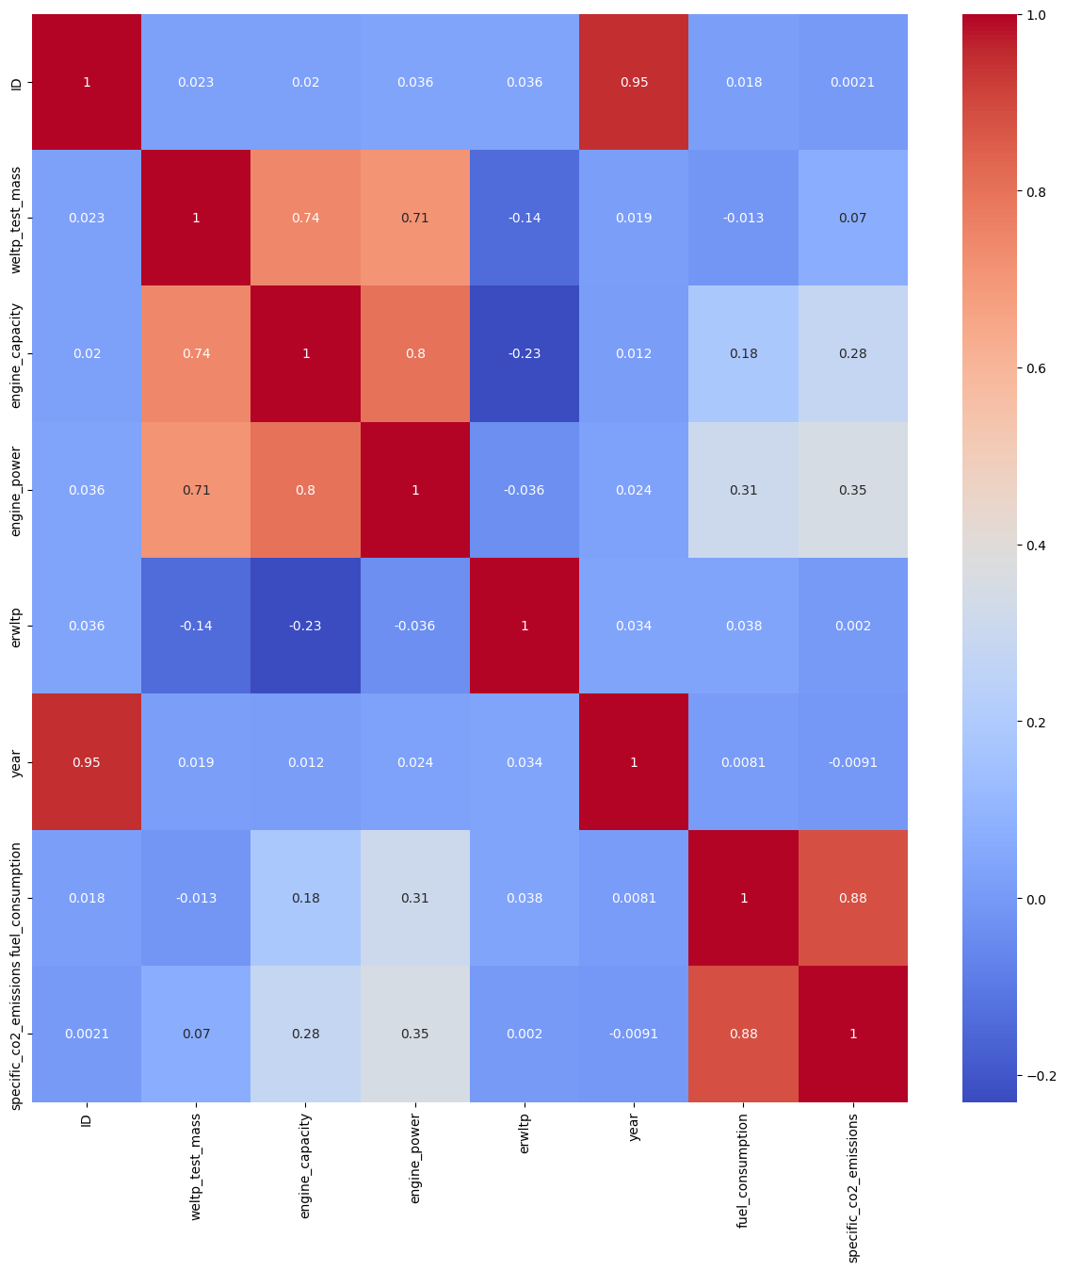
combustion engine - preprocessing
feature correlation heatmap
features with main influence:
wltl_test_mass
engine_capacity
engine_power
was expectable from the engineering point of view
heatmap underlines the choice to choose one of the possible targets and eliminate the other
(specific-co2-emission can be calculated out of fuel consumption)

Slide 15
combustion engine - preprocessing
>30% NaNs
specific-co2-emissions-wltp
target
drop columns
Standard Scaling
1 < x < 30%
Quantitative Vars
repair values (replaced by mean / mode)
data
<1 %
cleaned
Categorical Vars
LabelEncoding

Slide 16
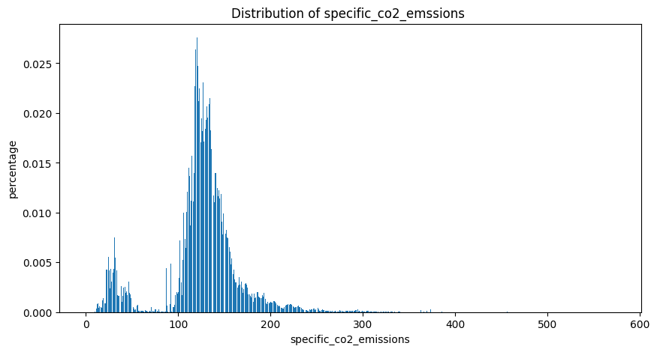
combustion engine - model-selection
distribution of target variable
focus was laid on the diesel and petrol engined cars
hybrid-electric cars and other fuel were not considered closer
since the target is a numerical variable
=> regression models were chosen
distribution of target-variable:
unit: g co2/km

Slide 17
combustion engine - model-selection
simple regression models
parameter Tuning
best results
LinearRegression
GridSearchCV:
LinearRegression
DecisionTreeRegressor
RandomForestRegressor
XGBoostRegressor
high computing time
XGBRegressor
ExtraTreeRegressor
RidgeCV
preprocessed data
LassoCV
RandomizedSearchCV:
XGBRegressor
ExtraTreeRegressor
RandomForestRegressor
less computing time
XGBoostRegressor

Slide 18
combustion engine - model-selection
Metrics used for evaluation:
rmse and score
GridSeachCV:
Parameter optimization by automatically trying out all combinations of the given sets of different parameters.
immense computing time without visible progress.
encountered by batching the train data down
testing was done with full datasize
trying out different search methods
introducing PCA on the dataset
Randomized SearchCV:
Parameter optimization by randomly putting together different combinations of the parameter sets.
a little faster than GridSearch, but still time consuming:
measures see above
Best parameters for the final models
XGBRegressor:
n_estimators: number of Trees used.
increased until no further improvement is seen.
GridSearch and RandomizedSearch => 1000
learning_rate: says how much the weight of the single trees is adjusted during training.
too high: danger of overfitting
too low: slower learning, more trees
GridSearchCV and RandomizedSearchCV => 0,2 0,3
ExtraTreeRegressor:
max_depth: max. depth of each tree. (betw. 0 and 10)
GridSearch and RandomizedSearch => None

Slide 19
combustion engine - final model evaluation
Metrics used
mae: mean-absolute-error
statistical measure for the error.
mse: mean-squared-error
statistical measure for the effectiveness of a model
r2-value: value of determination.
value between 0 and 1, saying how good a model’s predictions fit the data
values achieved
Model | best parameters | mae | mse | r2
XGBRegressor | n_estimators: 1000 Learning_rate: 0,3 | 1,3979 | 6,1054 | 0,9964
DecisionTreeRegressor | max_depth: none | 0,6220 | 4,8215 | 0,9972
ExtraTreeRegressor | max_depth: none | 0,6231 | 4,8309 | 0,9972

Slide 20
combustion engine - neural net
Neural net with keras
corroboration of the layout
keras Sequential:
simple structured, easy to built and understand
two dense layers with 1024 and 512 neurons
is a good choice for teaching this model with complex data.number of neurons was optimized by trial and error.
activation function “relu”:
common choice for nonlinear activation function
avoids “vanishing gradient problem” (very slow learning of first layers)
one dropout layer:
avoids overfitting
learn_rate was optimized by trial and error
one dense output layer: with one neuron and linear activation function.
ideal for linear regression problems
layer | Model | units | activation function
 | keras Sequential
1 | Dense | 1024 | relu
2 | Dense | 512 | relu
3 | Dropout | dropout: 0,001
4 | Dense | 1 | linear

Slide 21
combustion engine - neural net evaluation
Parameters for evaluation
epochs: 15
batchsize: 256
dropout: 0,001
trained with 2 percent of the original data
mae | rmse_train | rmse_test
4,5882 | 6,1878 | 6,3252

Slide 22
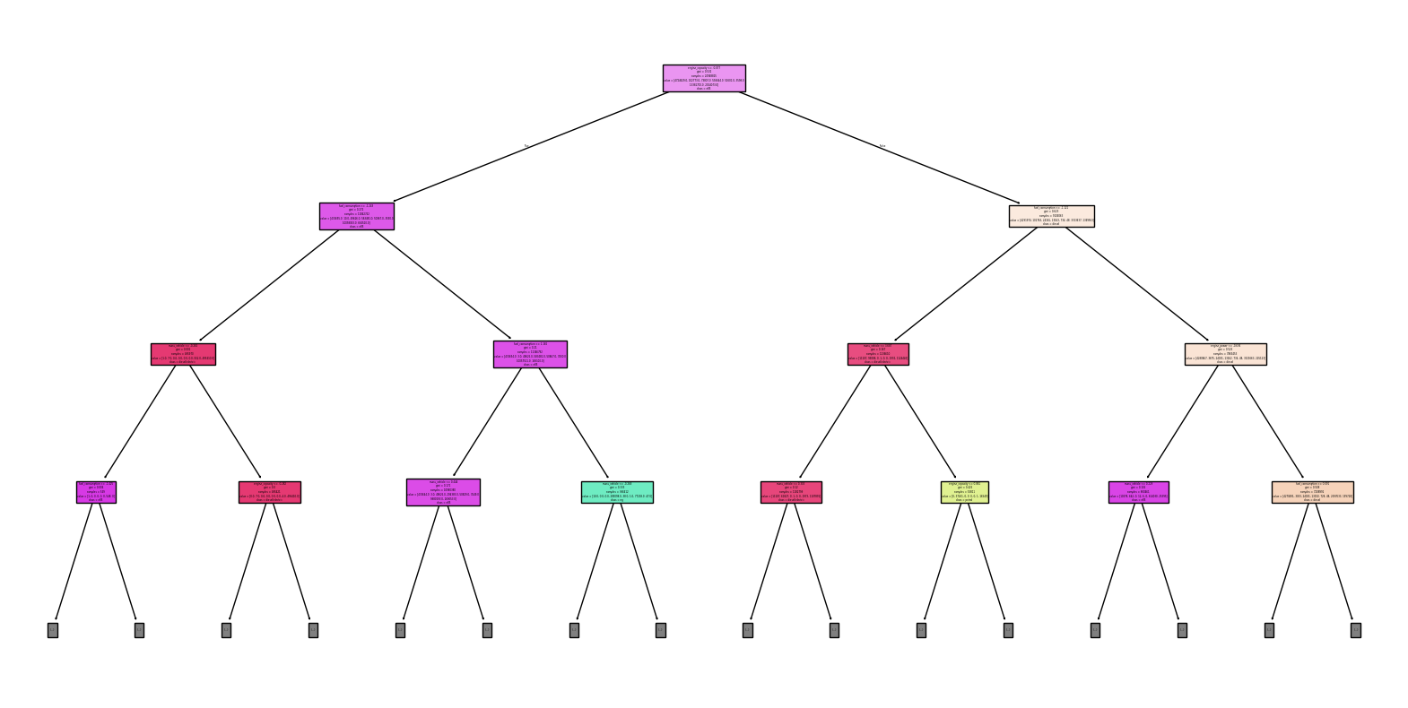
combustion engine - Classification Mini
Interpretability Experiments with Tree Models
best results with XGBoost
Random Forest & Decision Tree featured a high computation time

Slide 23
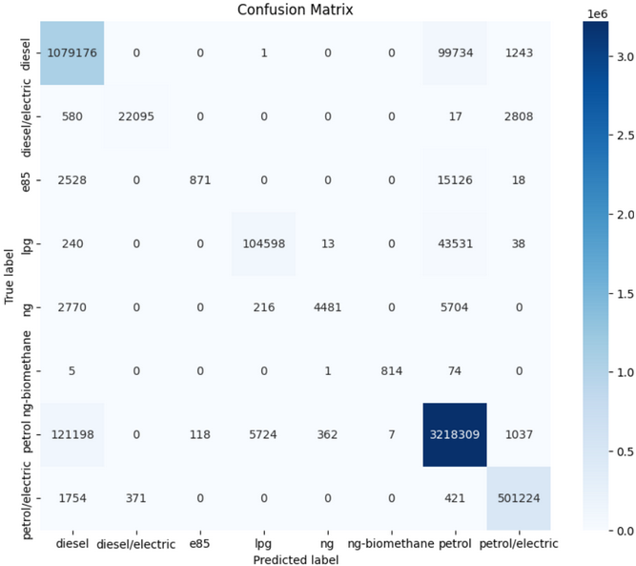
combustion engine - Classification Mini
Accuracy Results before Smote
Diesel: 91.45%
Diesel/Electric: 86.65%
E85: 4.70%
LPG: 70.01%
NG-Biomethane: 34.59%
Petrol: 94.15%
Petrol/Electric: 99.33%

Slide 24
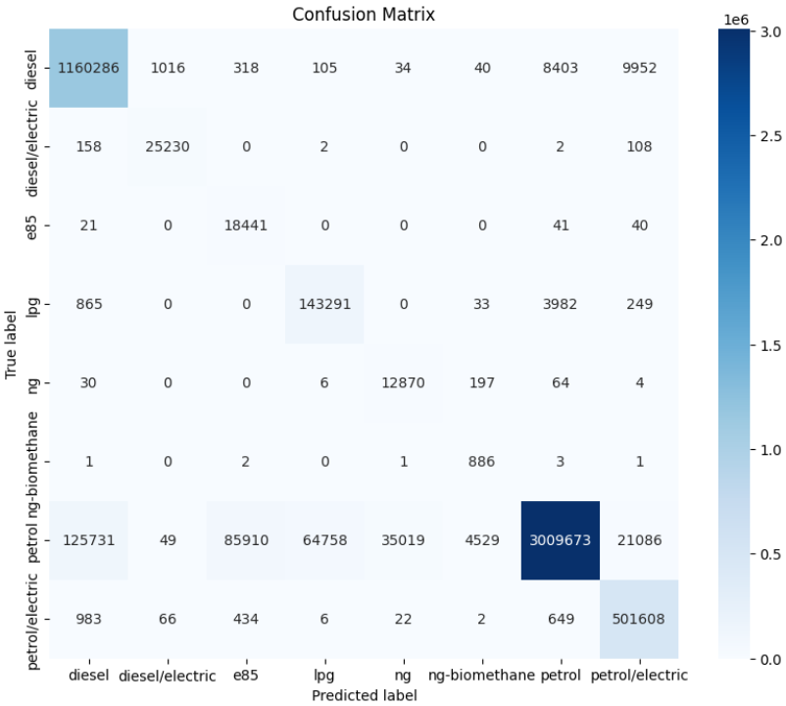
combustion engine - Classification Mini
Accuracy Results after Smote
Diesel: 98.57%
Diesel/Electric: 98.94%
E85: 99.45%
LPG: 96.54%
NG-Biomethane: 97.76%
Petrol: 88.44%
Petrol/Electric: 99.33%

Slide 25
Conclusion & Discussion
General Project Summary
Learning opportunity with however limited business impact due to time constraints
Decision to leave out translation of energy consumption to specific CO2 emission
Project Challenges
Hardware restraints & logistic issues of Datascientest laptop delivery/setup
No centralized storage for data resources
No prior knowledge of impact of large data amounts on performance
Time-consuming modeling stage
Often, knowledge beyond the scope of Lessons was required

Slide 26
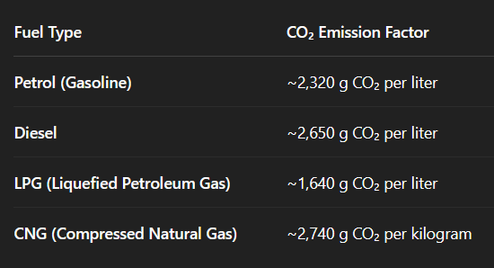
Conclusion & Discussion
Possible Next Steps - Modeling
Evaluation of models in regional subsets of data
Full-scale employment of SHAP
Expand optimization stage (Gridsearch parameters, Deep Learning models …)
Thorough application of Fuel-to-CO2-Emission formulas on model predictions

Slide 27

Conclusion & Discussion
Possible next steps - Integration of MLOps Tools:
MLFlow (Model Training/Versioning)

Slide 28

Conclusion & Discussion
Possible next steps - Integration of MLOps Tools:
MLFlow (Model Training/Versioning)
Docker (Deployment)

Slide 29

Conclusion & Discussion
Possible next steps - Integration of MLOps Tools:
MLFlow (Model Training/Versioning)
Docker (Deployment)
Kubernetes (Scaling of Containers)

Slide 30

Conclusion & Discussion
Possible next steps - Integration of MLOps Tools:
MLFlow (Model Training/Versioning)
Docker (Deployment)
Kubernetes (Scaling of Containers)
Jenkins (Continuous Integration/Deployment)

Slide 31
Conclusion & Discussion
Thanks for your attention!
All questions are welcome.

